Slide 1



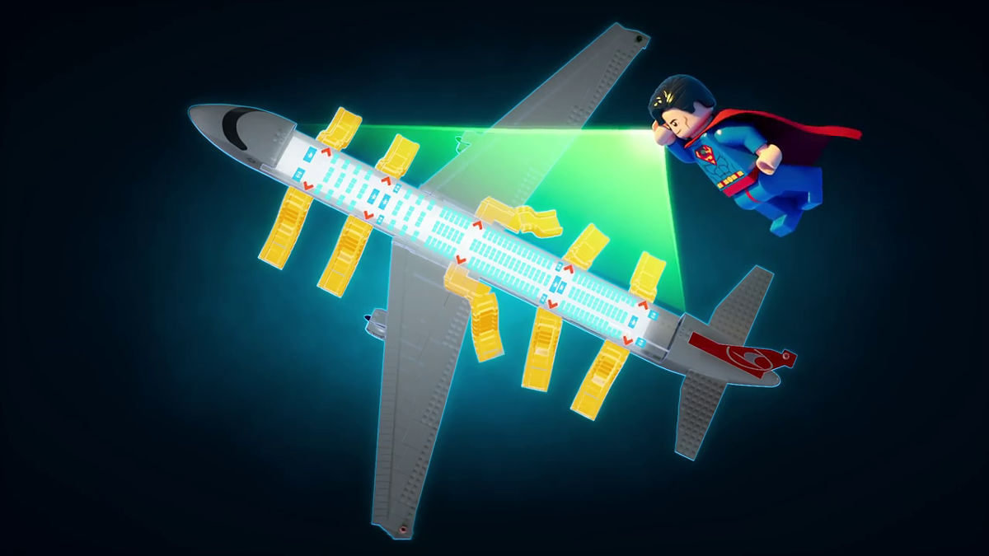
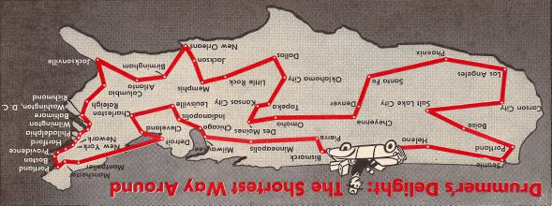
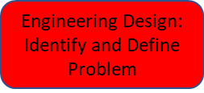
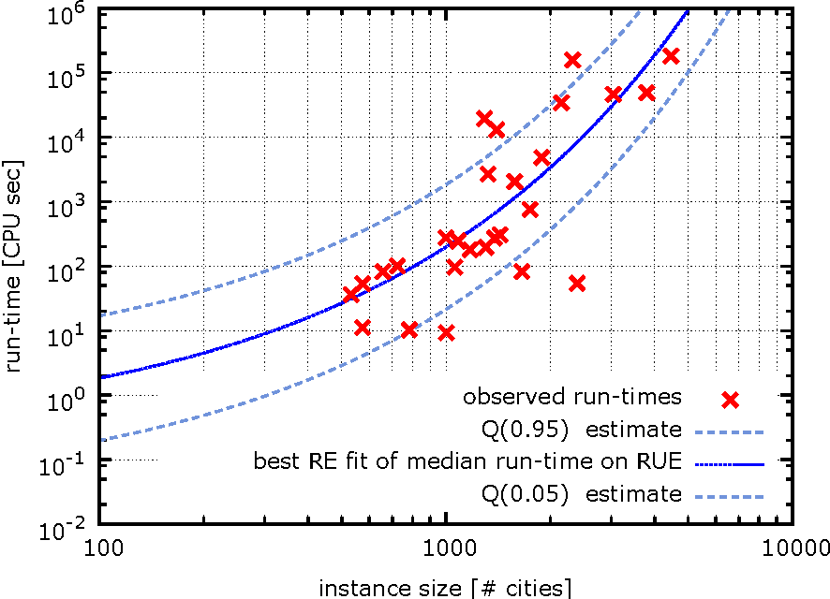
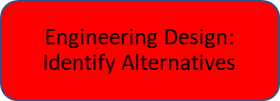

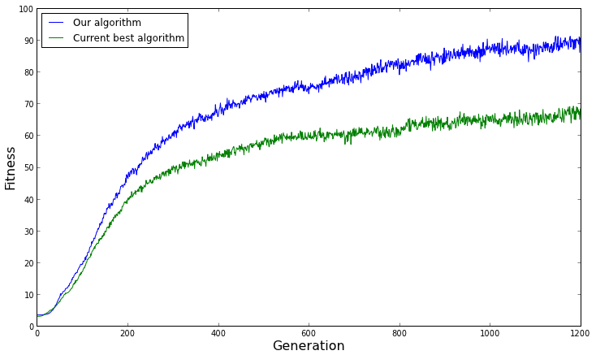
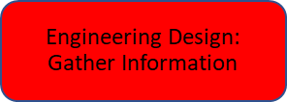
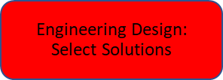

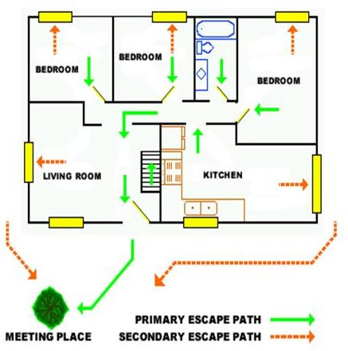


The Traveling Salesman Problem
What’s the Shortest Route?
Pedro Szyjka
Mathematics, Cincinnati State University
RET is funded by the National Science Foundation, grant # EEC-1710826
Traveling Sales-People
Want the Shortest Route
to All Their Locations
Enter Genetics Modeling
…The Best Survive….
Let’s Do An Experiment…
What’s the Best, Fastest Way Out?
Identify and Define the Problem…
Computation Time = Function of Number of Cities
Got N cities ? Order of N ! Possible Iterations
Design of Experiments is how to find out !
Engineering Design:
Select Solutions
A Classroom of 4 Teams Simulate in an Airliner….Collect
Evacuation Times/Number of People/Number of Exits Data
Is there a “Good Enough”… Cost Effective vs. “Perfect Solutions” ?
“Identify Alternatives”
….How many possible routes can the salesperson or delivery platform travel?
What is the shortest route? Lets “Gather Some Information”
The Number of Iterations Asymptote Before the Maximum Possible
We “Refine”
Engineering Design:
Refine
How can we use this in the “Real World?”
Engineering Design:
Evaluate Solution
FIRE !
They found the Best Configuration was
4 Exits with 10 People
Let’s “Implement that Solution”

